Slide 1
Winter Term 21/22 Adversarial Self-Supervised Learning with Digital Twins Lecture-5:Sim2Real
Prof. Dr. Holger Giese (holger.giese@hpi.uni-potsdam.de)
Christian Medeiros Adriano (christian.adriano@hpi.de) - “Chris”
He Xu (he.xu@hpi.de)

Slide 2
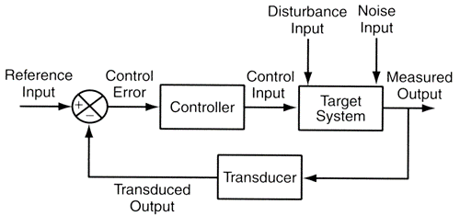
Infrastructure to run experiments
“Success in the Lab is not guarantee of success in the World.”
Feedback loop models
"When solving a problem of interest, do not solve a more general problem as an intermediate step. Try to get the answer that you really need but not a more general one." Vladimir Vapnik
Simulation models
"Thinking is acting in an imagined space" Konrad Lorenz
"Perception is a generative act" – [Gross et al. 1999]
" Consciousness is a controlled hallucination " - [Seth et al. 2000]
System State and Configurations
Intelligent System
Digital Twin
New Model Parameters

Slide 3
Operating in Sparse, Safety Critical, Uncertainty World
Operation produces few if any training examples (relevant events are rare)
Predictive performance is necessary but not sufficient
Simulation requirements for robustness are functions of the operational context, hence:
Requirements are domain-specific, which make them more challenging to automate
Their reification happens outside the machine learning algorithms
Requirements Engineering Questions
Which simulation requirements do we need?
How do we verify that these simulation requirements are being met?
How to incorporate these simulation requirements into training?
How do we transfer the simulation outcomes to production?

Slide 4
Advantages of Simulated Data
Cheaper: do not require long and error-prone system executions
Faster: can focus on a certain system state
More Scalable: can be parallelizable, be enriched via data fusion, etc.
Safer: does not risk catastrophic incidents in production
Higher Quality: pre-processed to be labeled, reduced measurement error, missing data, etc.
Less Biased / More Diverse: not limited to the real-world probability distributions

Slide 5
However, simulation is also difficult
Difficult to accurately & efficiently model sensors & the real-world
Small modeling errors can compound in large control errors (why? because they are correlated)
If there is some pattern (even accidental) in the data, the ML model will explore it.
Simulator make trade-offs between fidelity and speed, usually favoring the latter
Even if we model everything accurately, we still need to get the parameters right.
How to measure phenomena that is not directly observable in the data? In physical systems they correspond, for instance, to damping, inertia, friction, etc. Or in our systems, they can correspond to network instability, surge in user requests, hardware failures, tec.
The more accurate the model more parameters, more data, slower simulation.
Random error
Compounded error

Slide 6
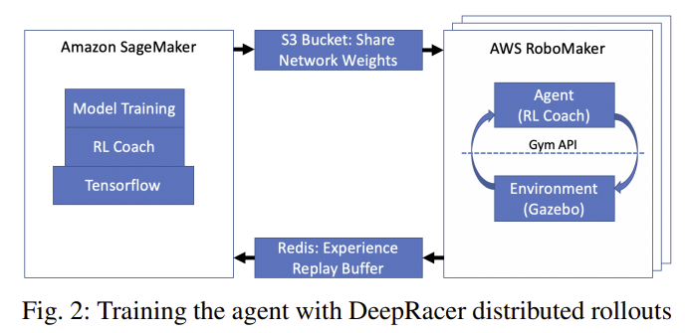
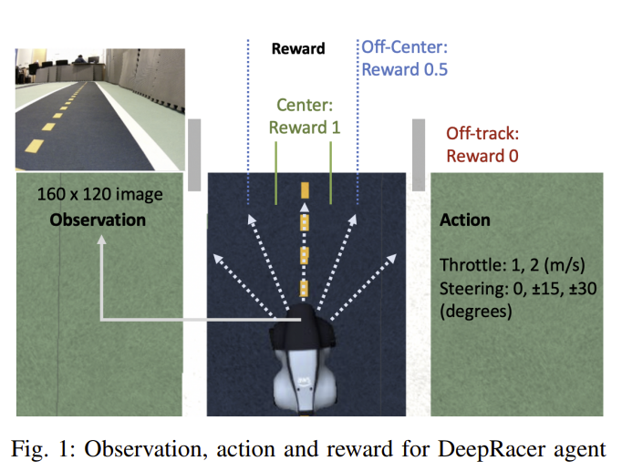
DeepRacer [Balaji 2019]
Sim2Real Calibration
Height, angle and the field of view of the simulation camera to match the real images
Use the same frame rate 15fps
Producer-consumer mechanism to ensure one action per image
Balaji, B., et al. (2019). Deepracer: Educational autonomous racing platform for experimentation with sim2real reinforcement learning.

Slide 7
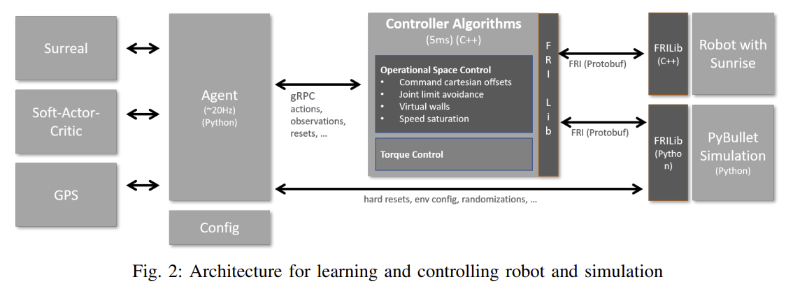
Sim2Real Transfer for Reinforcement Learning [Kaspar 2020]
Sim to Real Transfer
Simulation environment (PyBullet)
Dynamics and Environment Randomization
System Identification
Mitigate that initial simulation transferred to the real robot works too poorly.
Kaspar, M., Osorio, J. D. M., & Bock, J. (2020). Sim2real transfer for reinforcement learning without dynamics randomization. In 2020 IEEE/RSJ International Conference on Intelligent Robots and Systems (IROS) (pp. 4383-4388). IEEE.

Slide 8
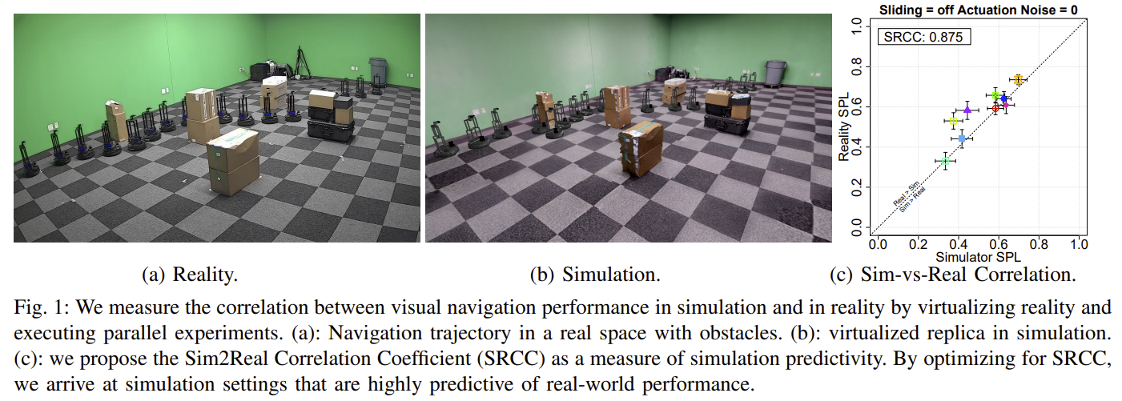
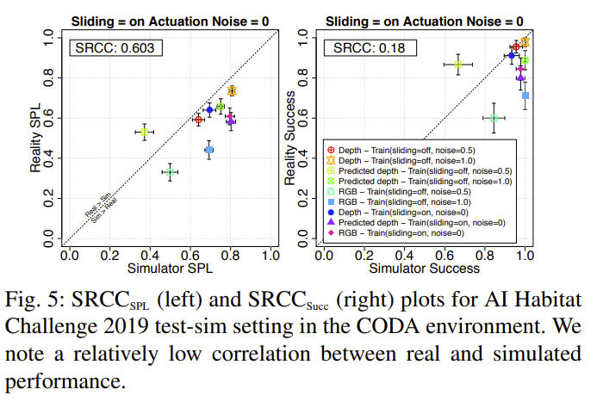
Sim2Real Predictivity [Kadian 2020]
Problem: Sim-vs-Real Correlation Coefficient (SRCC) to quantify predictivity = 0.18
Reason: The gap is largely due to AI agents learning to exploit simulator imperfections – abusing collision dynamics to ‘slide’ along walls , leading to shortcuts, through otherwise non-navigable space.
Solution: Their experiments show that it is possible to tune simulation parameters to improve sim2real predictivity (improving SRCC_Succ from 0.18 to 0.844) – increasing confidence that in-simulation comparisons will translate to deployed systems in reality.
Kadian, A., Truong, J., Gokaslan, A., Clegg, A., Wijmans, E., Lee, S., ... & Batra, D. (2020). Sim2Real predictivity: Does evaluation in simulation predict real-world performance?. IEEE Robotics and Automation Letters, 5(4), 6670-6677.

Slide 9
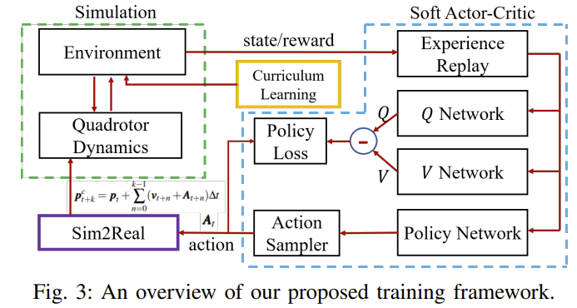
Further readings recommended
Traoré, R., Caselles-Dupré, H., Lesort, T., Sun, T., Díaz-Rodríguez, N., & Filliat, D. (2019). Continual reinforcement learning deployed in real-life using policy distillation and sim2real transfer
Xiao, C., Lu, P., & He, Q. (2021). Flying Through a Narrow Gap Using End-to-End Deep Reinforcement Learning Augmented With Curriculum Learning and Sim2Real.
IEEE Transactions on Neural Networks and Learning Systems.
Read in more detail and check citations
Kaspar, M., Osorio, J. D. M., & Bock, J. (2020). Sim2real transfer for reinforcement learning without dynamics randomization. In 2020 IEEE/RSJ International Conference on Intelligent Robots and Systems (IROS) (pp. 4383-4388). IEEE.
Kadian, A., Truong, J., Gokaslan, A., Clegg, A., Wijmans, E., Lee, S., ... & Batra, D. (2020). Sim2Real predictivity: Does evaluation in simulation predict real-world performance?. IEEE Robotics and Automation Letters, 5(4), 6670-6677.
Balaji, B., Mallya, S., Genc, S., Gupta, S., Dirac, L., Khare, V., ... & Karuppasamy, D. (2019). Deepracer: Educational autonomous racing platform for experimentation with sim2real reinforcement learning. arXiv preprint arXiv:1911.01562.
How to prevent catastrophic forgetting in sim2real

Slide 10
Why do we need a simulation of the world?
Observations not reliable, are high dimensional and multi-modal
Reward from real-world is hard.
The real world usually does not behave like an MDP (Markov Decision Process)
?
Sources of Difficulties
Latent variables
Brittle mechanisms
might not be independent and
Interventions can alter mechanisms
Sparsity of relevant events (failures, rewards)
Mitigating Solutions
model the world as a Partially Observable MDP (POMDP)
monitor the mechanisms for unexpected changes
simulate the transitions in a hypothetical world to accelerate learning

Slide 11
Definitions (informal)
Mechanism: is a sequence of causal events that propagates (usually through multiple paths) the effect of an intervention until one or more outcome variables
Intervention: consists of fixing to value or varying within a range of values one or more variables. An intervention on a node disconnects the node from its parents, i.e., make any intervention on the parents ineffective to the node.
Condition: consists of filtering events (rows on a probability matrix) by the value of variable (node). Conditioning does not cut the incoming arrows to the node, i.e., the node remains connected to its parents.

Slide 12


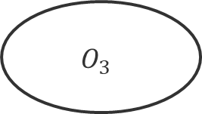
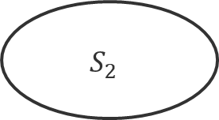


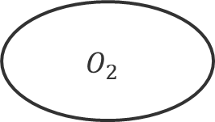
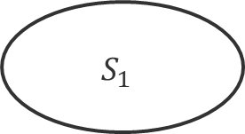
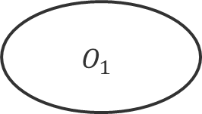





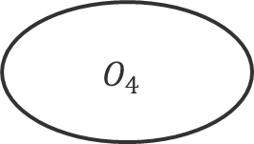


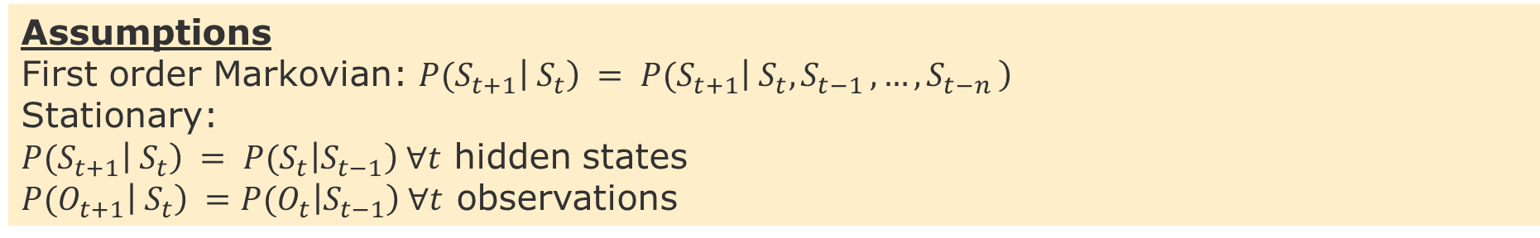
Hidden Markov Model - HMM
$$0.3$$
$$0.5$$
$$0.5$$
$$S_{1}$$
$$S_{3}$$
$$0.5$$
$$0.1$$
$$0.6$$
$$S_{4}$$
Hidden states
$$S_{2}$$
$$0.3$$
$$1.0$$
End
$$0.2$$
$$O_{1}$$
$$O_{2}$$
$$O_{3}$$
$$O_{4}$$
Observations
Assumptions
First order Markovian: ${P(S}_{t+1}\left|{ S}_{t}\right) = {P(S}_{t+1}\left|{ S}_{t},S_{t−1 },…,S_{t−n }\right)$
Stationary:
${P(S}_{t+1}\left|{ S}_{t}\right) = {P(S}_{t}\left|S_{t−1}\right) ∀t$ hidden states
${P(O}_{t+1}\left|{ S}_{t}\right) ={P(O}_{t}\left|S_{t−1}\right) ∀t$ observations

Slide 13


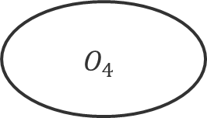





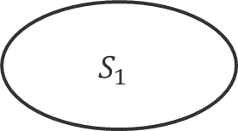
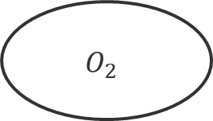




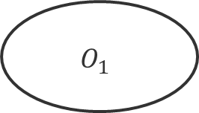





Partial Observable Markov Decision Process - POMDP
$$0.3$$
$$0.5$$
$$0.5$$
$$S_{1}$$
$$S_{3}$$
$$0.5$$
$$0.1$$
$$0.6$$
$$S_{4}$$
Hidden states
$$S_{2}$$
$$0.3$$
$$1.0$$
End
$$0.2$$
$$O_{1}$$
$$O_{2}$$
$$O_{3}$$
$$O_{4}$$
$$R_{1}$$
Observations
$$A_{1}$$
$$A_{2}$$
Actions and Rewards
While in the HMM we are passively observing and trying to infer the real state, in the POMDP we have partial control over the state transitions through the actions, whose effects produces a signal (reward Ri) for future actions.

Slide 14
Preliminary Work-Packages
1- Hidden Markov Model
Study how to move the HMM implemented in the Python side to the Java side
2- Failure Inject Mechanism
Study how to generate failure injects that reflect that failure propagation patterns
3- Reinforcement Learning
Study how to replace the Supervised Learning controller (Regression) with a Self-Supervised One (RL)
4- Monitoring
Study how to visualize the utility, risk, and mechanism gap between the Real and Simulated (Digital-Twin)
5- Adversarial Tests
Study how to generate stress tests that show how policies that have equivalent predictive outcome at training present distinct outcomes at adversarial test sets

Slide 15
Project Goals - Research Problems
1- Under-specification Problem
Goal: Show that different prediction models solve the task well for testing data, however, perform very differently in two distinct situations:
1.1 distinct hyper-parameters (prior knowledge)
1.2 out-of-distribution data (distribution shifts)
2- Value-at-Risk Problem
Goal: Show different rates of synchronization between Production and Simulation can lead to:
2.1 excessive cost of training and redeployment
2.2 increase in the risk of under-performance
3- Learning to Synchronize Problem
Goal: Show that different strategies to learn when to train and redeploy require:
3.1 more data to achieve an average value-at-risk
3.2 longer time to converge
Simulation
Sim2Real
Feedback Loop

Slide 16
Next tasks
Think about answers to the for the following questions:
How to generate test-data?
How to generate distribution shifts? How much shift (how to measure it)?
How to train distinct models that perform equally well on test data?
How do you know that two models are distinct?
How do you know that they perform equally well on the test data?
Preliminary assignment and ideas for the work-packages
Suggested Deadline = Nov 16 (present during lecture)

Slide 17
END

